Slide 1

Mount Auburn Medical Associates Patient Safety Improvement Project – Spreading Improvement
Community Learning Session #4
March 4, 2016

Slide 2
Aim Statement
Original goal: To have 100% of Dr. Cutler’s patients ages 50-80 to have a documented conversation regarding the Colon Cancer Screening by June 30, 2016
Present goal: To have each of our providers in Mount Auburn Medical Associates and Watertown Primary Care practices have 100% of their patients ages 50-80 have a documented conversation regarding Colon Cancer Screening by June 30, 2016

Slide 3

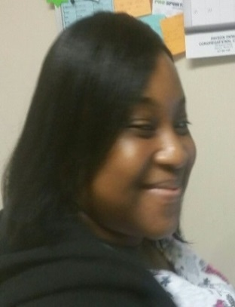
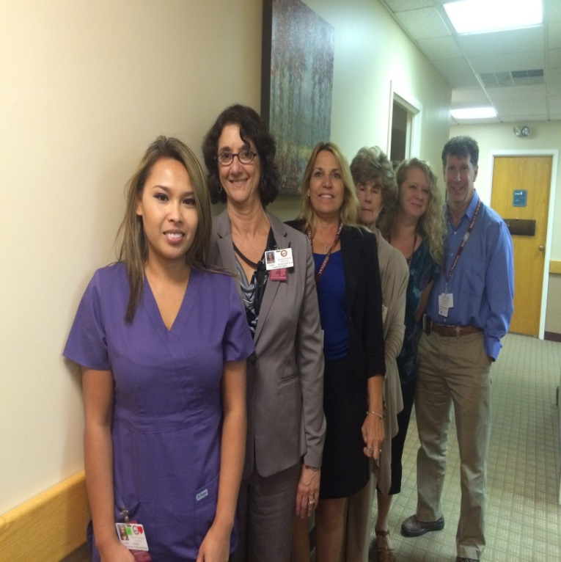
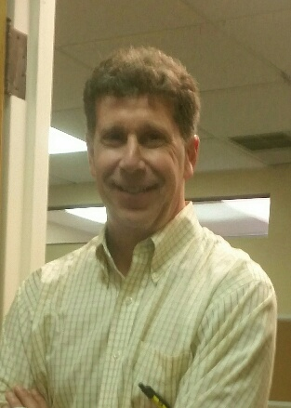
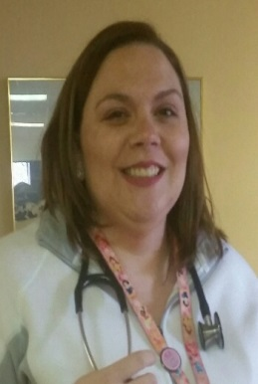
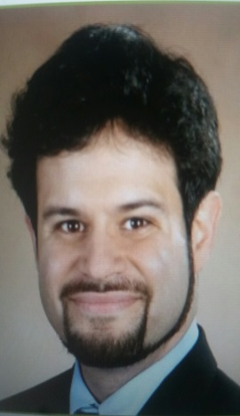

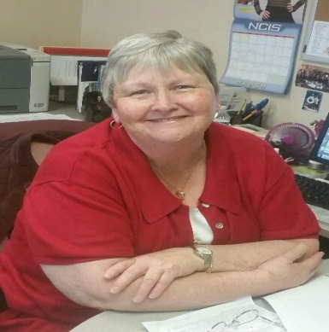

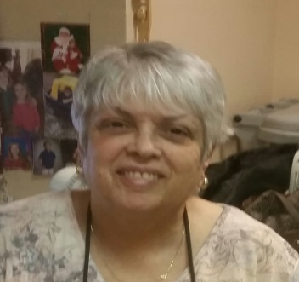

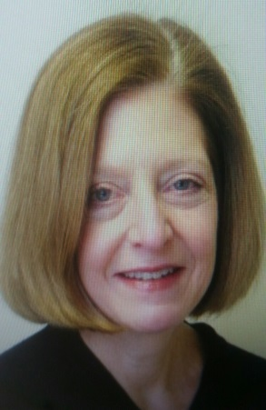

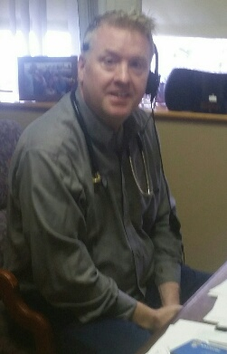
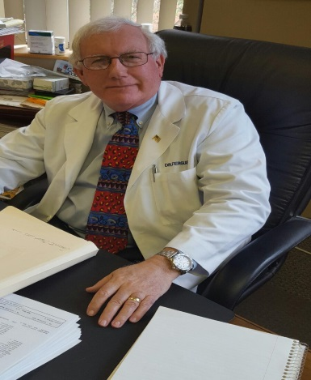
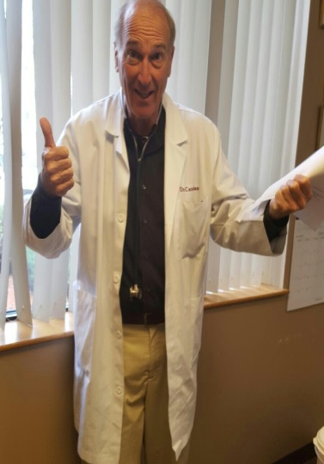
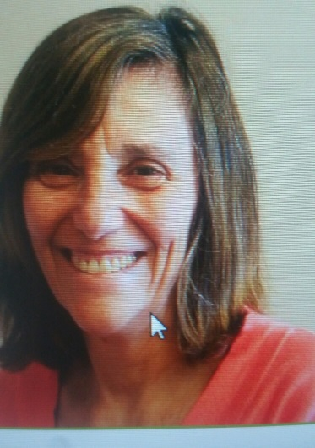

Team Members

Slide 4
The Mount Auburn Medical Associates Providers

Slide 5
What We Have Learned
Colorectal cancer is the second leading cancer killer — but it doesn’t have to be
Colorectal Cancer Screenings Saves Lives
Knowing WHO your patients are
Knowing WHERE your patients are at is the key to empowering your team to know HOW and WHEN to approach your patient for engagement

